Slide 1


From Financial Strain to Financial Gain:
Restructuring a Debt-Ridden School
Kaif Fazal | Roll No: 24F1002359 | IITM BS Degree Program

Slide 2
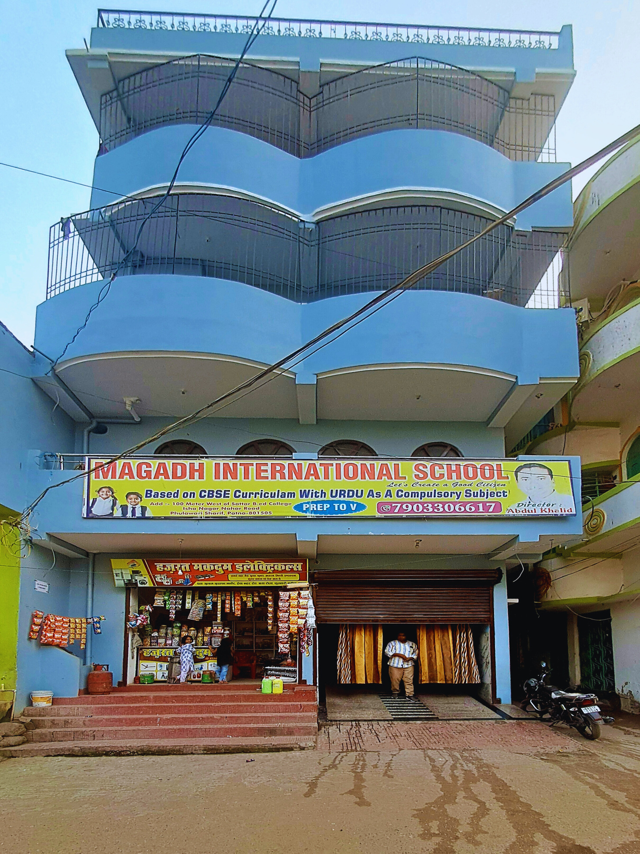
Page 2
About Organization
Magadh International School
Founding: Established in April 2024 by Abdul Khalid
Location: Situated in Phulwari Shareef, Patna, Bihar.
Curriculum: Follows the CBSE curriculum, with Urdu as a primary subject
Initial Grades: Opened with classes from Nursery to 3rd Standard; expanded to include 4th and 5th Standard shortly after.
Staff: Comprises 18 employees, including qualified teachers and support staff
Total students: 164

Slide 3

Page 3
Problem Statement
Financial Burden
High debt of ₹17.05L due to initial setup costs (rent, furnishings, staff).
Monthly EMI burden of ₹11,755 straining operations.
Enrollment Issue
Low student intake; revenue below expectations.

Slide 4





Page 4
Data Collection & Methodology
Data Collection | Data Cleaning & Extraction | Tools | Analysis
18–20 meetings (Oct 25, 2024 – Jan 15, 2025) School Records: Enrollment,salaries, tuition fees, expenses,debt (PTMs): Feedback from 30 parents Locality Surveys: Competitor analysis of 7 nearby schools | Manual extraction from fee receipts, registers, and bills into excel/sheet Data entry of enrollment, revenue, feedback Data Cleaning: removed duplicates. Data Transformation: Aggregated daily data into monthly trends i.e tea,water. | Google Sheets & Excel: Data structuring, visualizations, and calculations. Python (Pandas, NumPy, Matplotlib): Statistical analysis and trend plotting. Formulas: SUM,AVERAGE,COUNTIF | Descriptive: Understanding what is happening through statistics and visual. Diagnostic: Exploring why problems like debt and low enrollment are occurring. Prescriptive: : Recommending steps

Slide 5
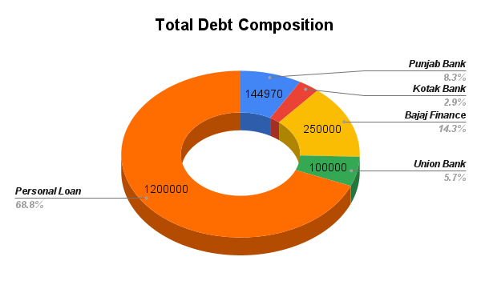
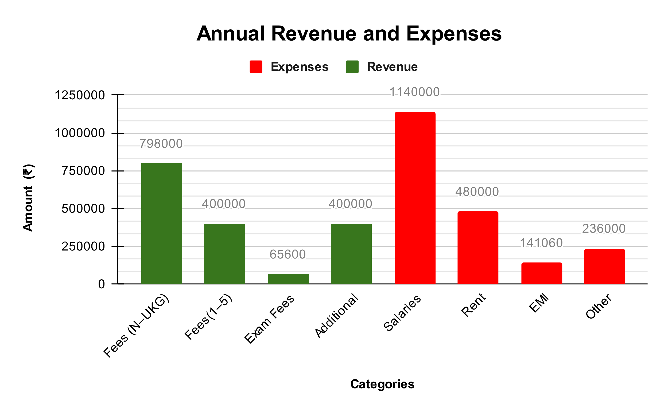
Page 5
Results and Findings
Majority of debt (≈ 69%) is personal loan from family/friends.
Institutional debt includes Bajaj Finance, Union Bank, and others.
EMIs total ₹11,755/month, creating constant pressure on cash flow.
Revenue heavily relies on tuition fees (₹7.98L) and services.
Major expenses: Salaries and Rent (₹4.8L).
Structural deficit of ~₹1.98L due to high fixed costs.
Total Monthly Revenue: ₹1,40,820
Total Monthly Expenses: ₹1,57,005

Slide 6

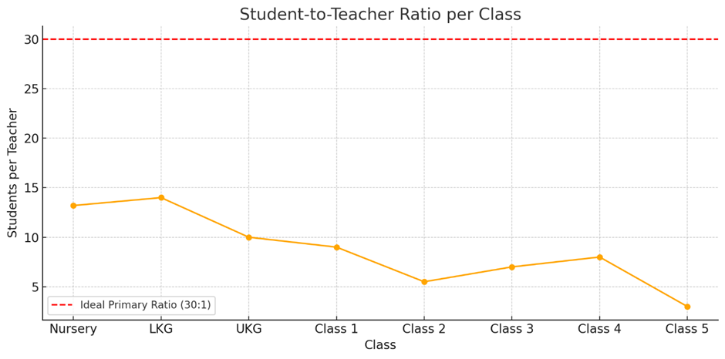
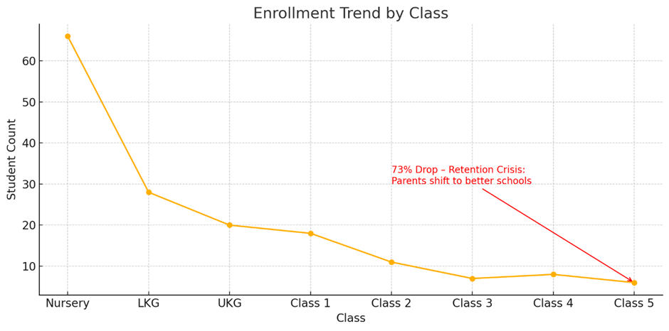
Page 6
Results and Findings
The overall Teacher-to-Student Ratio in the school is 1:11, meaning one teacher for every 11 students
Class-wise Analysis:Nursery has the highest ratio (1:13), while Class 5 has the lowest (1:3).
The Nursery class has the highest enrolment (≈ 66 students), indicating strong admissions at the entry level.
Parents tend to shift children to better-equipped schools post-Nursery.
Enrolment in Classes 3 and 4 stabilizes, but numbers remain low in higher classes

Slide 7
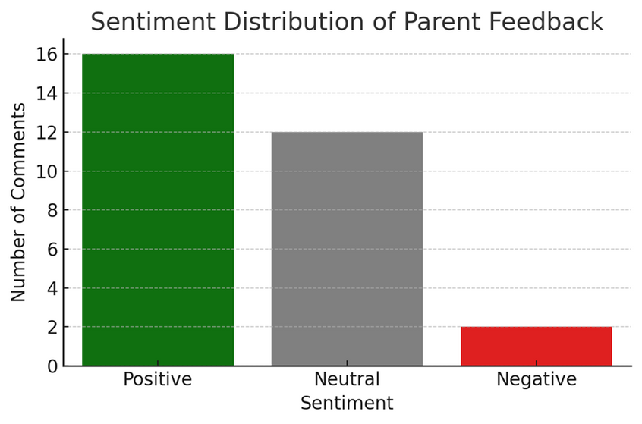
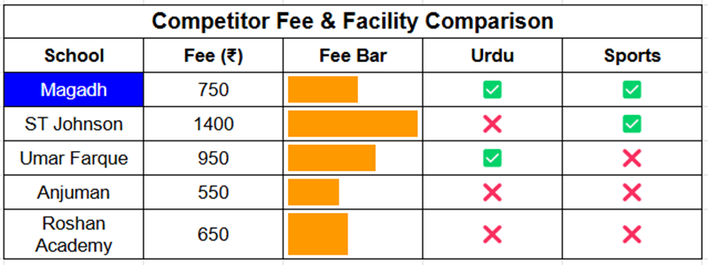
Page 7
Results and Findings
Magadh has the lowest fee among peers offering Urdu.
Magadh is one of only two schools offering Urdu, and the only one to offer it at such a low price.
• Teaching Quality: 7.5/10
• Facilities: 7.5/10
• Fees: 8.5/10
• Parents are most satisfied with fees
• Most criticism focused on Nursery workload

Slide 8


Page 8
Magadh International School runs a deficit of ₹1.98L/year driven by fixed costs (salaries + rent = 83% of expenses). The current debt burden of ₹17L adds pressure via EMIs. Without cost reduction or revenue expansion
Interpretation of Results
The school successfully attracts students at the foundational level (Nursery), indicating strong brand recognition and trust among parents in the local community. Teacher-Student Ratio is overly generous at 1:11, while CBSE recommends up to 1:30 for primary education.
The school’s USP lies in low fees + Urdu offering, which competitors lack. However, lack of sports/labs is a disadvantage. Parents gave 62% positive sentiment, which is a strength.

Slide 9

Page 9
Strategic Plan
Objectives | Improve Enrollment | Increase Revenue Streams | Reduce Operational Costs
Action Steps | -Start Pre-Nursery (age 2.5–3 years) with a play-based curriculum. - Introduce sibling discounts | -Implement development fee -Implement Admission fee - Add transport service - Introduce after-school programs | - Shift 3 FTE teachers to part-time - Reduce Teaching staff
Impact | Short-Term Impact: new enrollments. Approx. ₹15k/month additional revenue. Long-Term Impact: Improvement in Nursery student retention. Stronger brand positioning. | ₹1.3L/year from existing 164 students (₹800 each). ₹30K/year additional from ~30 new admissions. | -(Quick Wins) Maintains academic quality while reducing salary expenditure by up to 25%.

Slide 10
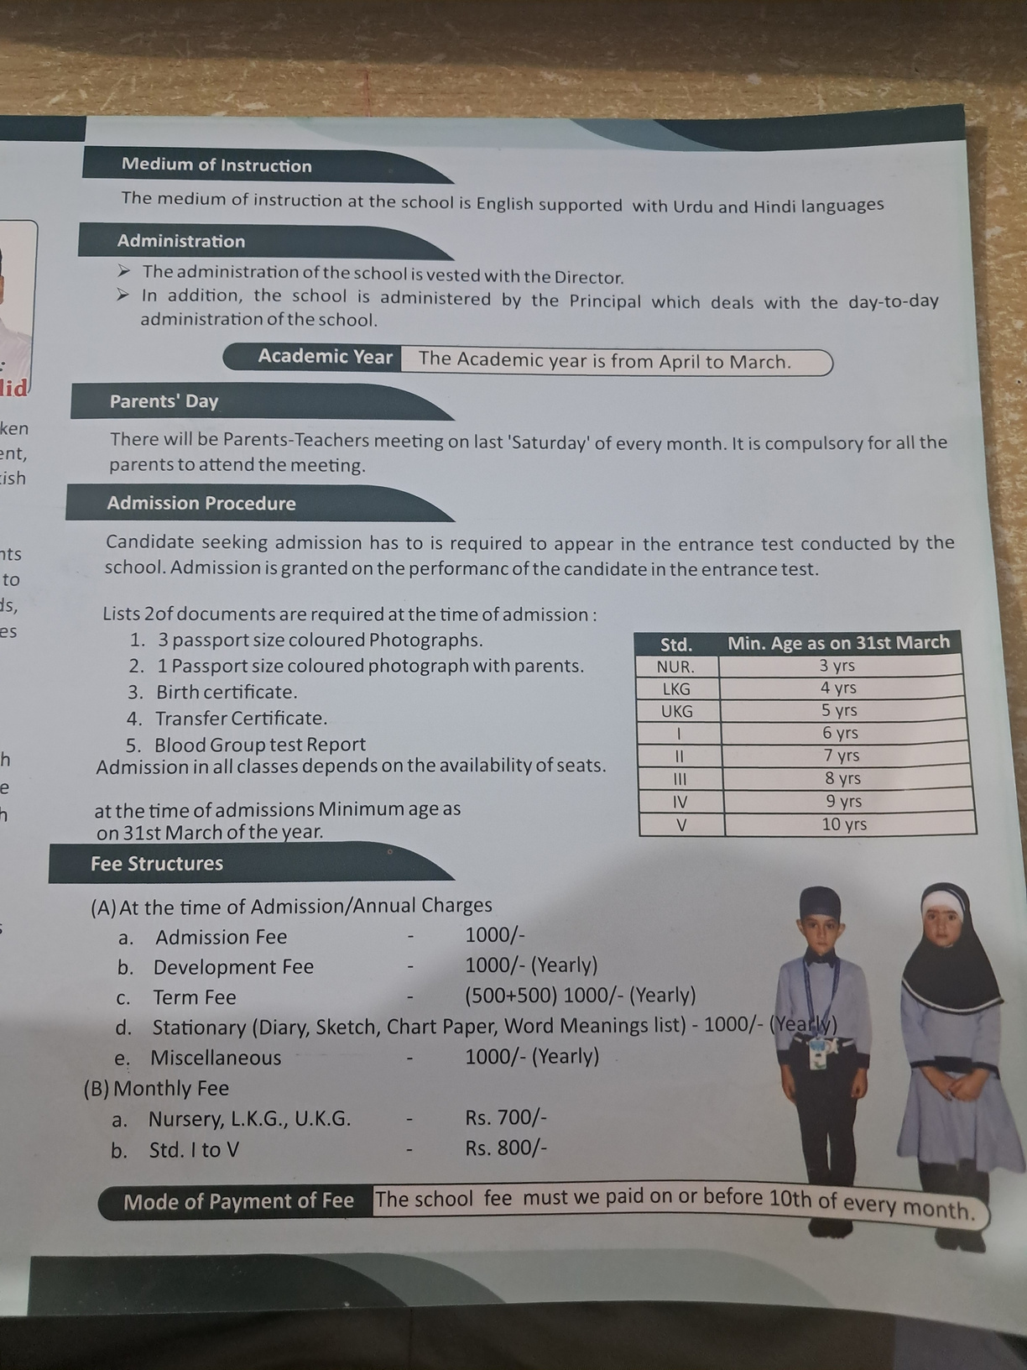
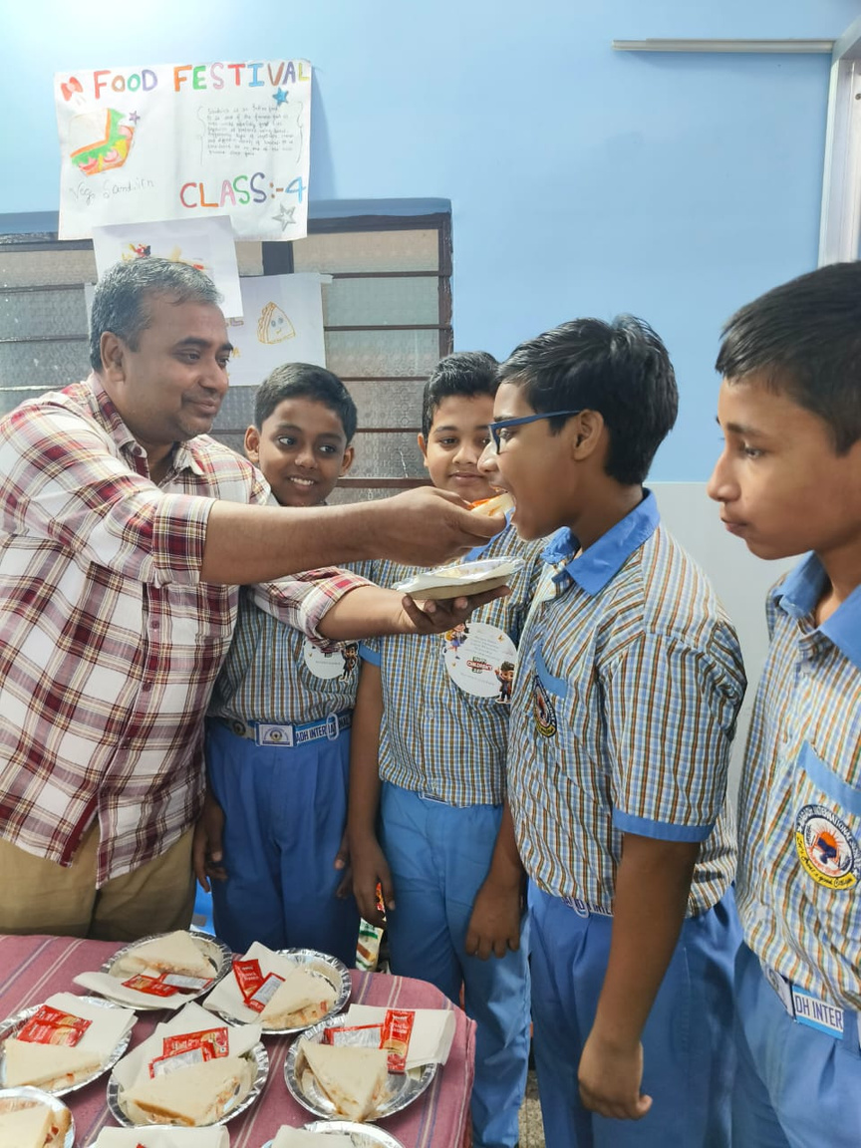

Page 10
Conclusion
01
The proposed interventions — such as launching Pre-Nursery and introducing sibling offers — are expected to bring immediate enrollment growth and new revenue streams.
02
These strategies directly address the school's core challenges: low retention, high fixed costs, and dependence on tuition fees.
03
Cost optimization measures, like part-time staffing, are projected to save up to ₹2.8L annually without compromising quality.
04
With phased execution, Magadh International School can shift from a ₹1.98L deficit to a financial surplus, while fulfilling its mission of affordable, inclusive education.

